Slide 1
Omdena Australia Chapter Technical Presentation
Tanya Dixit, Adish Ashraff, Bhushan Chougule, Nikhil Shrestha, Mary Adewunmi, Nica Medrano

Slide 2


The Problem
COVID-19 had a big impact on the mental health of people all around the world.
In Australia, the mental health issues have escalated.
For example, Lifeline saw several historical record high daily call volumes.
Beyond Blue received 20% more calls in 2021 than in the same period in 2019 (data from 19th Aug to 19th Sep)

Slide 3
The Project Goals
What is it
Scope out mental health issues in Australia
Make coping strategies accessible
What it’s not
The aim is not to prescribe any therapy, but to help people maintain their daily-wellbeing.
For this, we executed the challenge in 4 distinct steps:
Finding out what the key to mental health and well-being is
Identifying technologies that can help
Building a prototype chatbot based on our findings
Understanding mental health issues

Slide 4
Project Roadmap
Scope: To create a proof-of-concept chatbot that can help people answer FAQs on mental health, suggest daily well-being habits, and for resources on mental health.
Integration tasks
Analysis
Modelling
Data collection
Research
Chatbot creation
Deployment
Week 1
Week 2
Week 3
Week 4

Slide 5
Data Collection
#Official Data
Three Forums/Surveys were found, namely
COVIDiStress
ABS Survey
Social Impact Survey
#Chatbot Datasets
Counsel Chat chatbot dataset which contains conversations and suitable replies from mental health professionals like therapists, etc.
#Social Media
Twitter was scraped using SNScrape, which allows scraping twitter for a date range and location, using specific keywords relevant to Mental Health AUS.
#Forums
Surveys/ interviews/ forums where people openly share their concerns
Reddit
FAQs

Slide 6
Data Analysis
EDA processes such as word-cloud, topic modelling, sentimental analysis, tweets labelling etc.
This was used to inform the chatbot stories and intents
Key insights:
We went with EDA and understanding the sentiments of the people though tweets, official sites, forums, data for chatbots etc.
Using word-clouds, topic modelling and EDA on the data gave us an understanding as to what could be possible labels associated with tweets, some popular topics (good habits, popular issues etc).
We created labels and sentiments using huggingface transformer (zero-shot-classifier) which uses BERT backend and also using VADER for creating sentiments.
People also contributed towards making self explanatory graphs like bar-chart etc that further descriptively explored the data.

Slide 7
Research
Research Paper on “Joybot: A chatbots to boost Mental health of Australians “
Achieved a uniqueness of 91% - plagiarism test
Four(4) out of 5 Research objectives was achieved

Slide 8
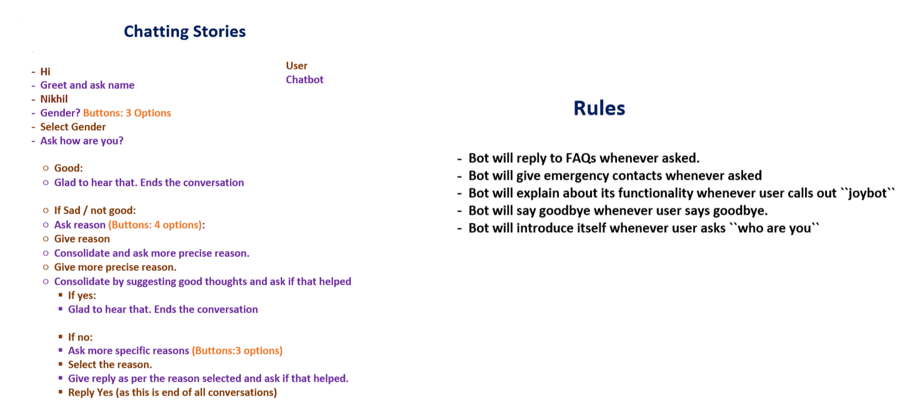
Chatbot
Link for Chatbot Description (Documentation)

Slide 9
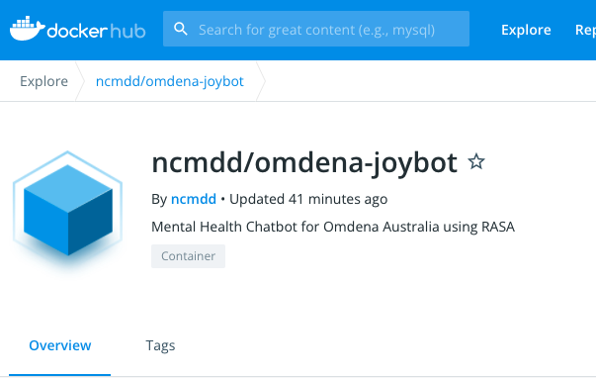
Docker Codes
local machine
docker build -t ncmdd/omdena-joybot .
docker login
docker push ncmdd/omdena-joybot
azure machine
docker pull ncmdd/omdena-joybot
docker run -it -p 8080:8080 ncmdd/omdena-joybot run --enable-api --port 8080
docker run -it -p 8080:8080 ncmdd/omdena-joybot shell --enable-api --port 8080

Slide 10
Way forward
A big challenge is creating something that will instill habits
Next challenge:
involve counselors, mental health professionals
roll out the chatbot to users

